Slide 1
Warrnambool
6th March
Cognitive Abilities

Slide 2

Cognitive Abilities Associated with Autism
Many autistic children :
Perform at the extremes of cognitive ability
Have a conspicuously uneven profile of academic achievement
Have a distinctive learning style
Have a history of being self-taught for reading and mathematics (speak with a foreign accent)
Prefer to use their own methods.

Slide 3
Assessing the Learning Profile
This can include a formal assessment of intellectual abilities
The psychologist explains how the profile affects learning and potential curriculum modifications
Classroom assessment by the teacher who acquires an understanding of educational qualities and difficulties, personality and motivation
The teacher and teacher aid modifies the classroom curriculum to accommodate the characteristics of autism as expressed by a specific child, for individual and whole class activities
A teacher aid has an extremely important role adjusting the curriculum for the child

Slide 4

Visualizers
Engineers and Artists
Learning may be facilitated by silent demonstration ‘A picture is worth a thousand words’
A difficulty converting thoughts and feelings into words (42)
A visual and solitary learner, not a social, conversational learner
Computer Curriculum – (no social and language processing)
Auditory processing: “Too many voices”
Sequence of actions in photographs or video
Auditory working memory:
create a mental video

Slide 5

Verbalizers
Relatively advanced verbal reasoning skills
Understanding what is written rather than said
Well-developed vocabulary and information
Understanding may be improved by reading about the concept
Talent with languages and classic literature

Slide 6
Motivation
Common motivators:
Intrinsic interest (linked to special interest)
Completion and perfection
Access to preferred activities
For personal achievement – Sense of self based on academic achievement

Slide 7

Processing Time
Slow processing time
Processing linguistic, cognitive and social information
Very thorough
Focussing on details – Trapped in the detail
Checking all links
Lose marks on timed tests because of an inability to work fast due to processing time, being pedantic, being distracted by details and handwriting problems

Slide 8
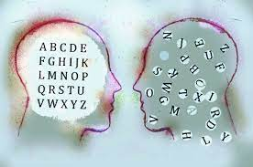
Reading
Can be better at reading accuracy than comprehension
Effects in the high school years on academic ability and on self-esteem
Need for an early assessment and intervention
Conventional remedial reading programs have not been as effective as with typical children

Slide 9

Reading
Perception, width of focus
Perception of letters (Irlen overlays)
Change the font, a new word
Reading: Word retrieval problems
Hyperlexia, to acquire knowledge on a special interest

Slide 10
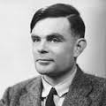
Mathematics
Talent or a difficulty
Mathematics is the study of patterns
Numbers can be perceived as shapes, not quantity
When talented, difficulty explaining in words how they achieved the answer

Slide 11

Mathematics
Enjoyment of the rules and certainty associated with calculations and tables
Mathematics ability can include areas of mathematical difficulty

Slide 12
Numbers by David LeBlond
I like numbers
they just add and subtract
they don't hurt your feelings or over-react
Now they're not much to look at (though 8 is not bad)
they don't make you love them or make you be sad
You can count on numbers
to make things work out
there's no second guessing
no worry or doubt
One thing about numbers
that won't be denied
they play by the rules
- you cannot hide
Numbers are my respite
my port in the storm
when the world's cruel and cold
they are safe and warm
If you make a mistake
or forget where you're at
they just won't forgive you
... we need people for that

Slide 13

Handwriting

Slide 14
Handwriting
Fuentes et al (2009) Neurology
The problem is forming the letters
Not the ability to correctly size, align and space the letters
Due to general difficulties with motor control affecting hand and arm movements
Kushki, Chan and Anagnostou (2011) Journal of Autism and Developmental Disorders 41
Impairments in fine motor control
Visual-motor integration

Slide 15

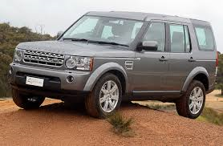
Cognitive Flexibility: One-Track Mind

Slide 16

One Track Mind
Train track
The last to know and seek help if they are on the wrong track
Lose train of thought if interrupted

Slide 17

One-Track Mind
Continue using incorrect strategies and not learning from mistakes
Not listening to advice
Not seeing trains on other tracks
Compulsion for completion (switch tracks)

Slide 18
One-Track Mind
Anxiety increases cognitive rigidity
Relaxation programs
Be calm in order to listen, absorb and try an alternative strategy
Advance notice of a change to create a new track
Too many choices overwhelming
Transitions a challenge

Slide 19

Problem Solving and Frustration
‘Thermometer’ of distress
Quickly ‘hit the panic button’
Intense negative emotional reaction
Giving up quickly ends the pain
Inhibits learning

Slide 20

The Mental Filing Cabinet
Intense emotions ‘lock the filing cabinet’
Need to calm down to access strategies

Slide 21
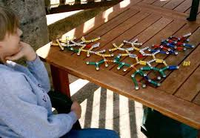

Patterns and Sequences
Talent and interest in identifying patterns and sequences
Identifying areas where the pattern breaks
Identify errors and mistakes (social consequences)

Slide 22
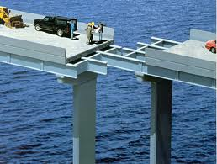
Mistakes

Slide 23
Fear of Making a Mistake
A phobic reaction
Don’t try, you don’t make a mistake
The teacher asks me to hurry up, but if I do, I might make a mistake
Fear of appearing stupid and being ridiculed by peers
Mistakes prove you are stupid
Cannot change your mind as, to do so, would be to admit having previously made a mistake
Allergic to errors
Self-imposed level of perfection and self-criticism

Slide 24

Coping With Mistakes
Self-perception as an adult
Limited ability to tolerate frustration
Have no plan B (flexibility in thinking, one track mind)
Not to be perfect every time, this is just a draft
An adult’s ability is not perfect.
Vocalize how you cope with frustration.

Slide 25

Mistake Strategies
Approach an error as an opportunity and data
Being calm is being smart (fall in IQ)
Physical strength and intellectual strength
“If I stay calm, I’ll find the solution quicker”

Slide 26
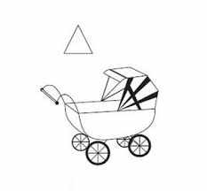
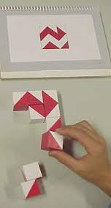
Weak Central Coherence
A reduced ability to draw together diverse information to construct a higher-level meaning.

Slide 27
Weak Central Coherence
Remarkably good at attending to detail but appear to have considerable difficulty perceiving and understanding the overall picture or gist
Looking through a rolled-up tube of paper
What is relevant and redundant?
Deciphering the general meaning.

Slide 28
Weak Central Coherence
Noticing patterns not perceived by others
Originality in problem solving
Walking into a strange room
Attention to detail in art (Penny, Deltic Train)

Slide 29
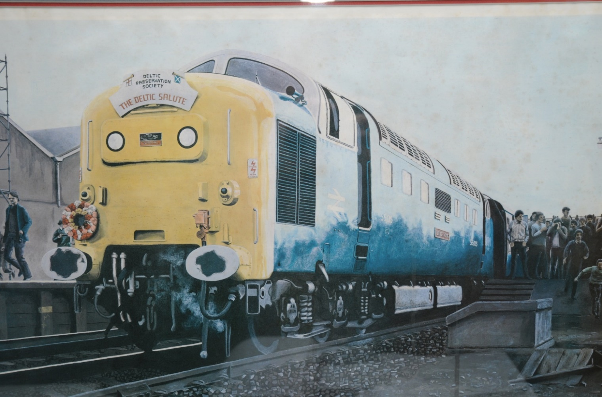

Slide 30


Slide 31
Effect of WCC in Areas of Ability and Behaviour
Non-Verbal Communication: Seeing parts of a face, frown: angry, worried or old
Language: Pedantic, an over-emphasis on detail, and a problem summarizing
Organizational skills: Problem prioritizing and unconventional organizational systems
Social skills: Identifying the relevant social cues

Slide 32
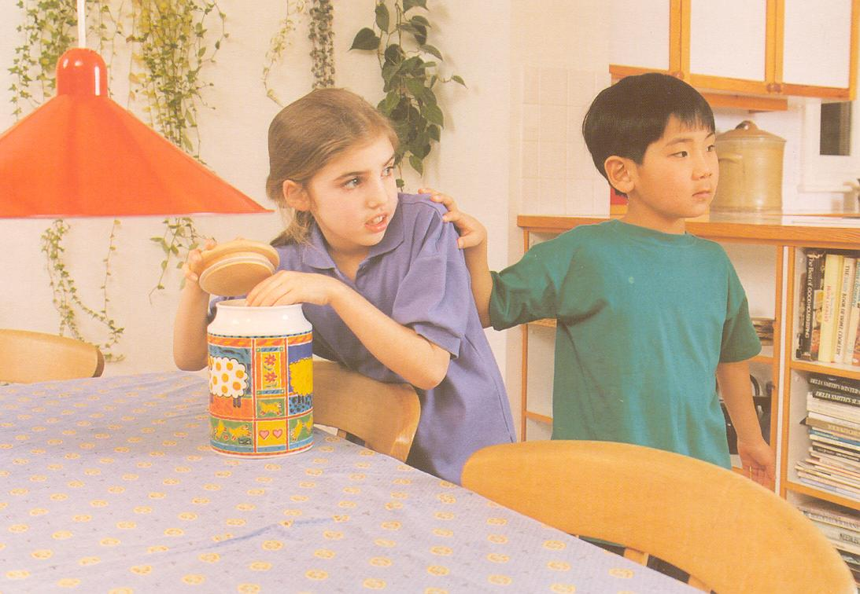
Effect of WCC in Areas of Ability and Behaviour
Notes:
32

Slide 33
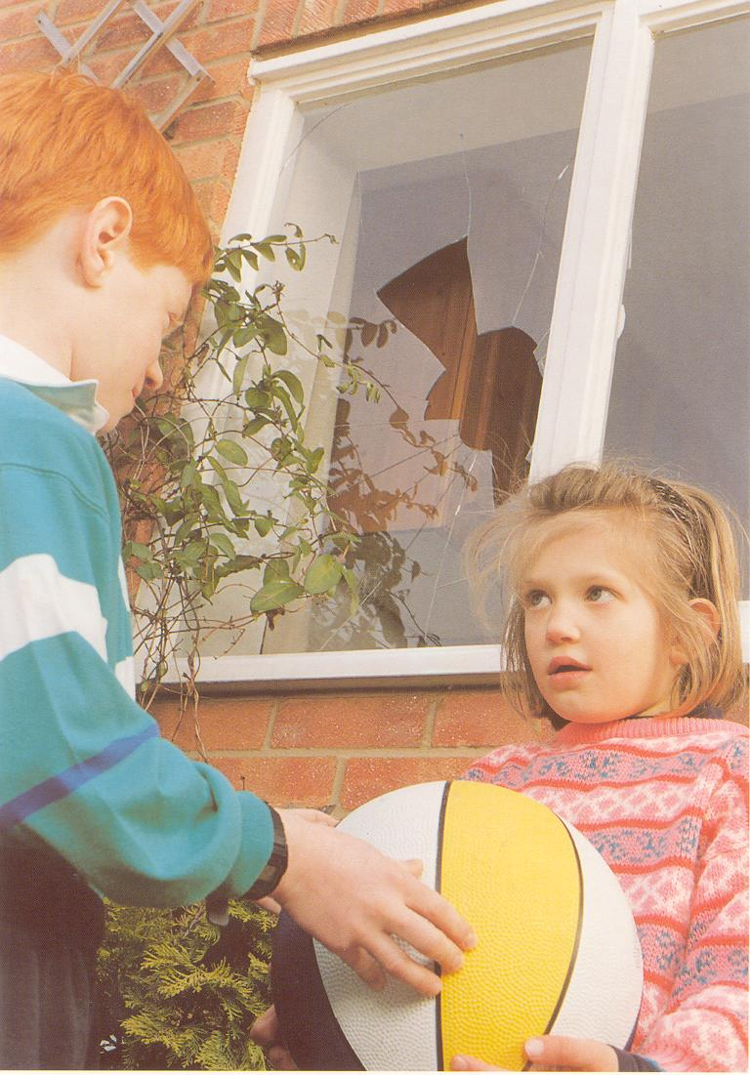
Notes:
33

Slide 34
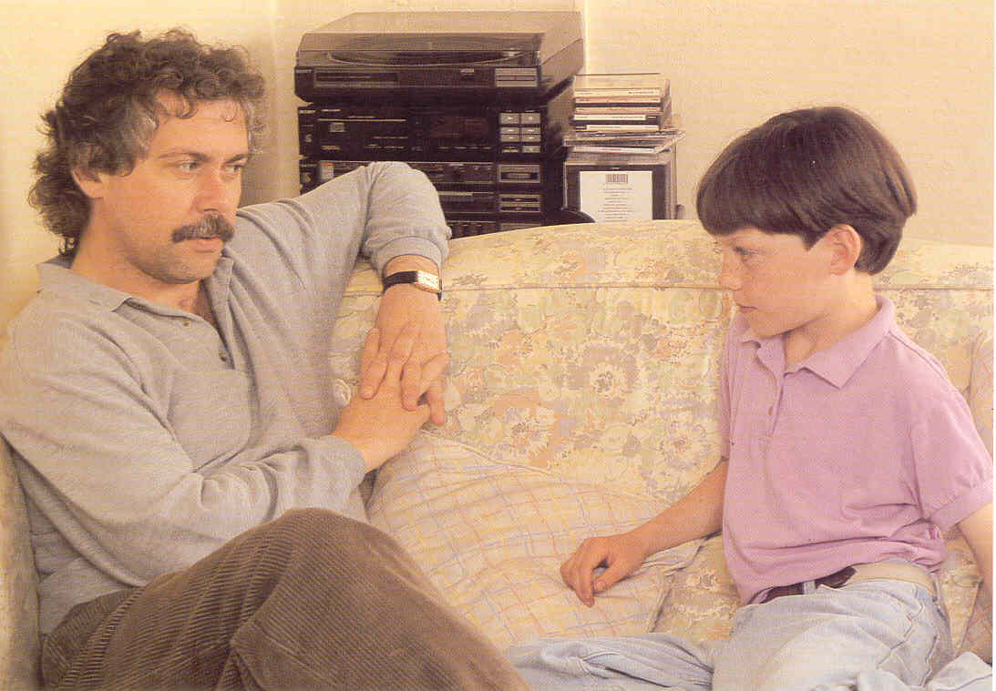

Slide 35
Adolescence: Executive Function
Planning how to do an activity
Organising what you need
Recall Forgetting what to do
Prioritize What I enjoy or is easy rather than what I need to do
Time perception Knowing how long it will take to complete the activity

Slide 36
Executive Functioning and Autism
Distractibility
Disorganised work area
Needing prompts to start and maintain work
Highlight important instructions or information
Coordination between home and school, diaries and email contact
Assistance from a friend/peer, to perhaps ask them before asking the teacher
Information sheets to refer to in addition to spoken instructions

Slide 37
Executive Functioning and Autism
Make a list in a notebook of what is needed and cross off those items before commencing the activity.
Take a mobile phone photograph of the equipment or resources needed.
Planning tasks over a day, a week and a month
A paper diary or electronic schedule app
Estimate the amount of time needed for each activity and create a time schedule/flow diagram

Slide 38
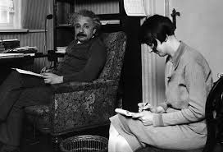
Need an Executive Secretary

Slide 39

Resources

Slide 40
Stress and Mental Exhaustion of Secondary School
The educational and social curriculum.
Pruning the High School curriculum
Absence of real breaks for relaxation and recovery
Bullying and teasing – school a ‘war zone’ –school refusal and suspension

Slide 41

Homework Strategies
Create a learning environment.
Homework timetable and diary.
Time allocation.
Segments with breaks.
Motivation.
Is it worth it?

Slide 42
Examinations
Sensitive to an anxious atmosphere in the exam room
Guidance and reassurance in reading and understanding the question – literal interpretation
Typing rather than handwriting
Gaps within the exam for emotional and energy recovery

Slide 43


The Essential Manuals for Autism in the Classroom
Kathy Hoopmann

