Slide 1
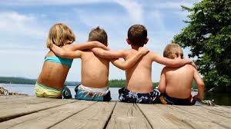
Warrnambool 7th March
Making Friends

Slide 2
Four Stages in the Development of Typical Friendships

Slide 3
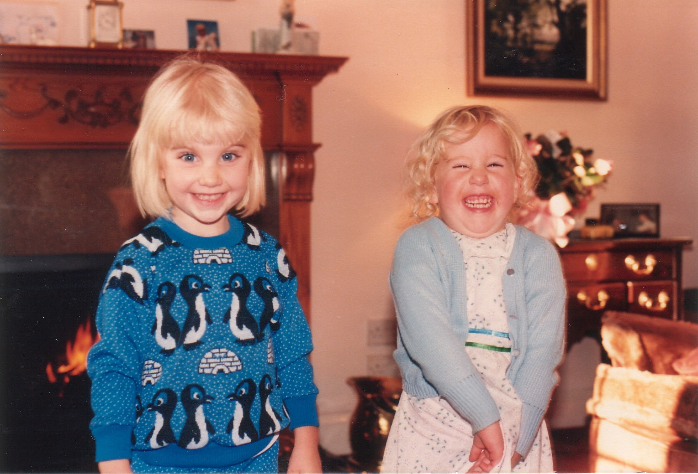
Stage 1 3-6 Years

Slide 4
Stage 1: Approximately 3 to 6 Years
Recognition of sharing and turn-taking.
Friend has toys the child wants to play with.
One-way assistance (he helps me).
Proximity
Why is ….. your friend?
“She sits next to me.”
Momentary, superficial friends.

Slide 5
Stage 1 Friendship Research
Chang Shih and Kasari 2016 Autism 20 (1)
Friendships in preschool ASD children
Only 20% had friendships at school
Few adults in the classroom tried to intervene to encourage engagement with peers
Involvement was to correct behaviour and tidy up

Slide 6
Strategies: An Adult ‘Acting’ As a Friend
Observe the natural play of the child’s peers, learn the games and rules.
Learn ‘child’ speak.
Turn taking.
Ask for help.
Video replay of social play scenes at school.
Pause button.

Slide 7
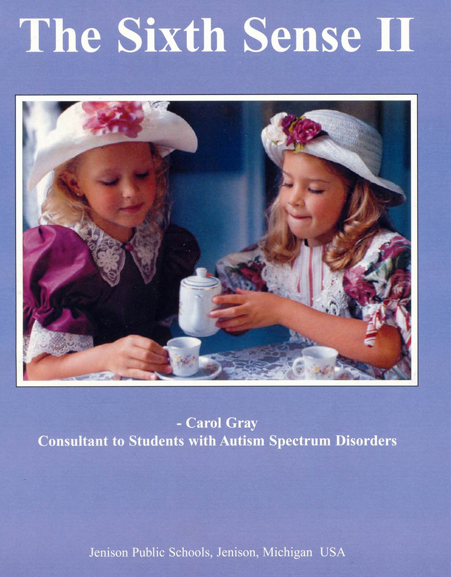
Typical Peers Facilitating Friendship
‘Recruiting a friend.’
Inclusion with typical children as they can modify their social play to accommodate the child.
Carol Gray’s Sixth Sense (the Social sense).

Slide 8


Social Stories
Start with a story about social success.
Half of Social Stories to record social successes.
Social articles for teenagers
Two examples

Slide 9
A Social Story on Assistance
Sometimes children help me. They do this to be friendly. Yesterday, I missed three math problems. Amy put her arm around me and said, “ It’s okay, Juanita.” She was trying to help me feel better. On my first day at school, Billy showed me my desk. That was helpful. Children have helped me in other ways. Here is my list:
I will try to say, “thank you” When children help me.

Slide 10

Two-Person Hugs
Sometimes two people hug one another. It’s a two-person hug when both people hug at the same time.
A two-person hug often means hello or goodbye.
Sometimes, people use two-person hugs to share their feelings. These hugs may mean, I love you, We are both happy, or We are both sad
When two people hug each other at the same time, they often:
Stand close facing each other
Wrap one or two arms around the other person
Squeeze a little but not a lot
The hug ends when either person begins to relax
their arms

Slide 11
Social Curriculum: Stage 1
Logic and Understanding in a Social Story
Observation of good practice (demonstration)
Fun watching what not to do
Guidance and encouragement
When you were playing outside, I noticed that…
Guidance and encouragement for peers
Autistic child being a social policeman

Slide 12
Social Curriculum: Stage 1 Topics
The Indices of Friendship Scale www.tonyattwood.com.au
Entry skills (cues, greeting and welcome)
Assistance (given, sought, copes with)
Accepting suggestions (incorporating ideas, agreement)
Reciprocity (conversation, activities, not dominant or subordinate)
Sharing (resources, attention)
Interest (listening, looking)
Avoiding (seeks solitude appropriately)
Ending (closure)

Slide 13
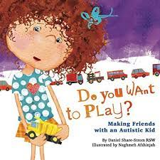
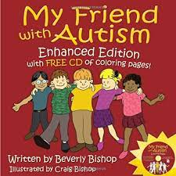
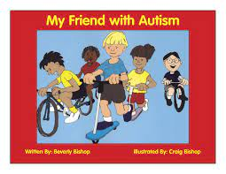
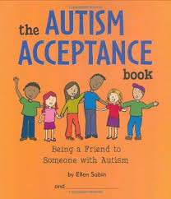

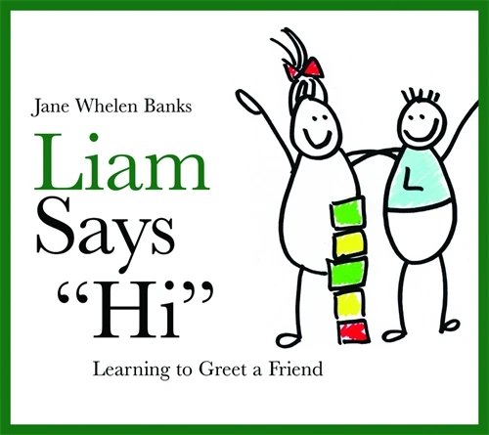
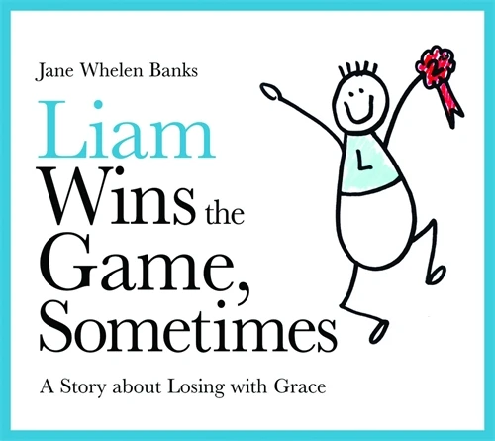

Slide 14
PEERS for Pre-schoolers
Tripathi et al. (2022) Journal of Autism and Developmental Disorders 52, 2610-2626
29 parents reported on child and family outcomes 1-5 years after treatment, the study confirmed sustained improvements
16 sessions including themes such as:
Meeting and greeting friends
Sharing and giving a turn
Asking for a turn

Slide 15
PEERS for Pre-schoolers
Sportsmanship, keeping cool and being a good sport
Show and tell during play
Asking a friend to play
Joining a game
Asking to play something different
Asking for and giving help
Staying in your own space
Using an inside voice
Using polite words

Slide 16
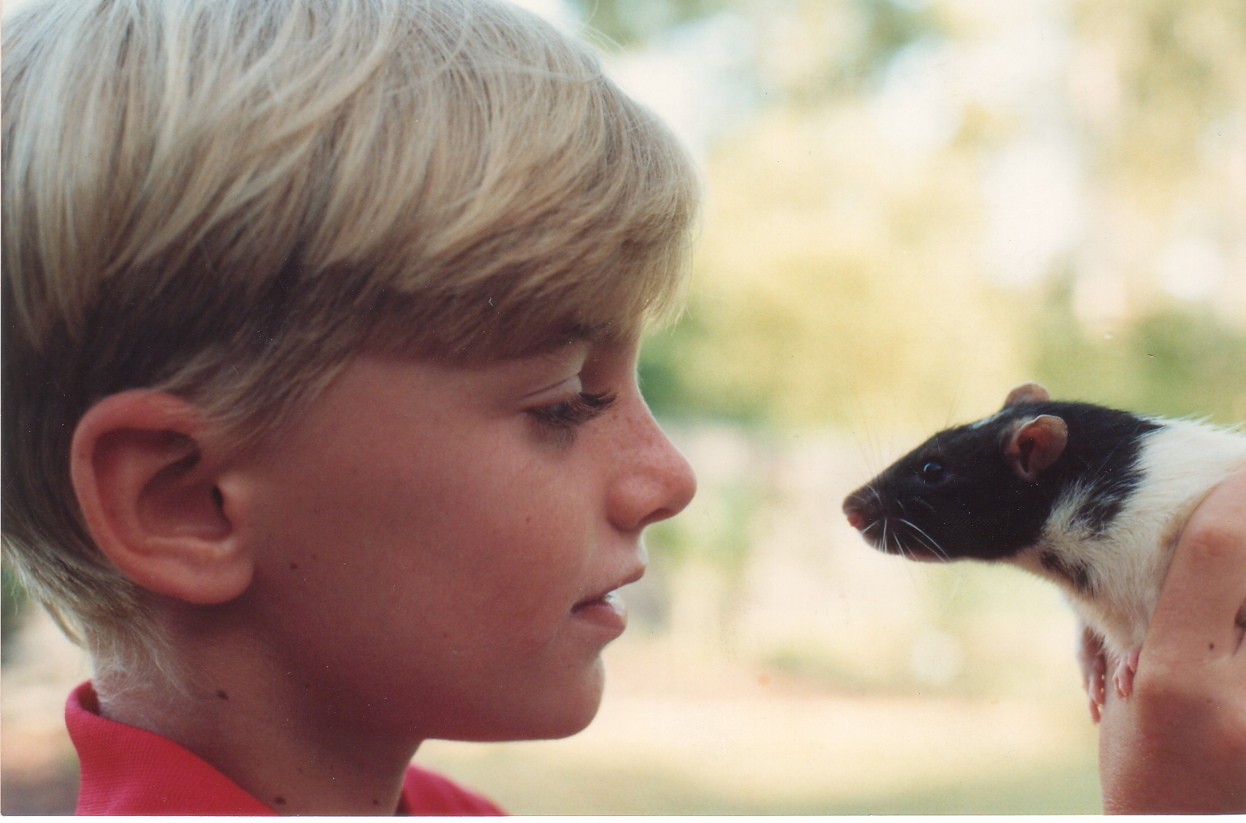
Stage 2 6-9 Years

Slide 17
Stage 2: Approximately 6 to 9 Years
Reciprocity and being fair.
Mutual assistance.
Like the same activities.
Why is …. your friend?
“She comes to my party, and I go to hers.”

Slide 18
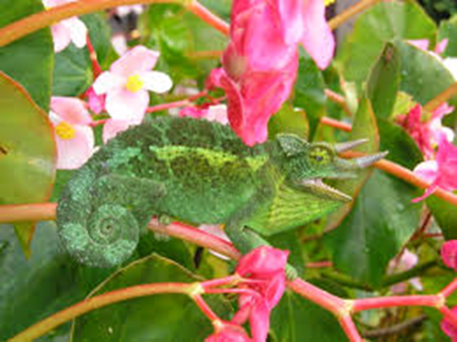
Strategies to Acquire Social Inclusion
Observe, analyse and imitate, creating a social mask
Absorption of the speech, mannerisms and character, even persona of someone who is socially successful.
Chameleon
Reading fiction helps to learn about inner thoughts and feelings
Decode social situations in doll play and talking with imaginary friends

Slide 19
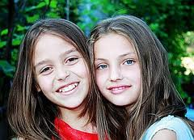
Friendships for Autistic Girls
Peer support (not bitchy).
Single friend who provides guidance and security.
Unpaid social teacher aid in the classroom and playground
The intensity of the friendship

Slide 20
Identify with boys
Many stereotypical girls activities were stupid, boring and inexplicable.
It is more accurate to say that I am gender-neutral. As a child, I liked to play with boys because I enjoyed toy cars, Lego building blocks, sports and that kind of thing, and sadly girls are not often given toys like cars and blocks; also, girls were more complicated and unkind in ways I didn’t understand.
Boys are more logical, and accepting, you can see what to do

Slide 21
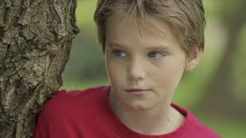
A Tomboy
It was easier to identify with boys because they just wanted to have fun. Girls had more social rules to follow or blunder. They had more gossip and didn’t like to get dirty. The guys were fun and I could almost be myself around them.
I don’t know how to do girl things.

Slide 22
Stage 2 Activities
Role play activities with peers
Rehearsal, feedback and rewards.
Social engineering (modelling and protection).
Resources

Slide 23
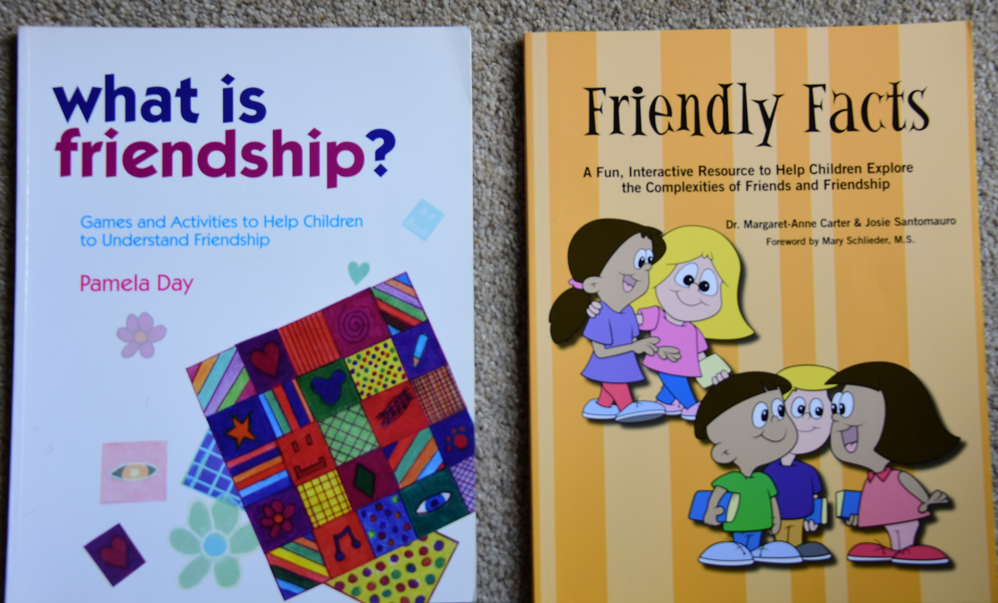

Slide 24


Theory Of Mind Skills

Slide 25
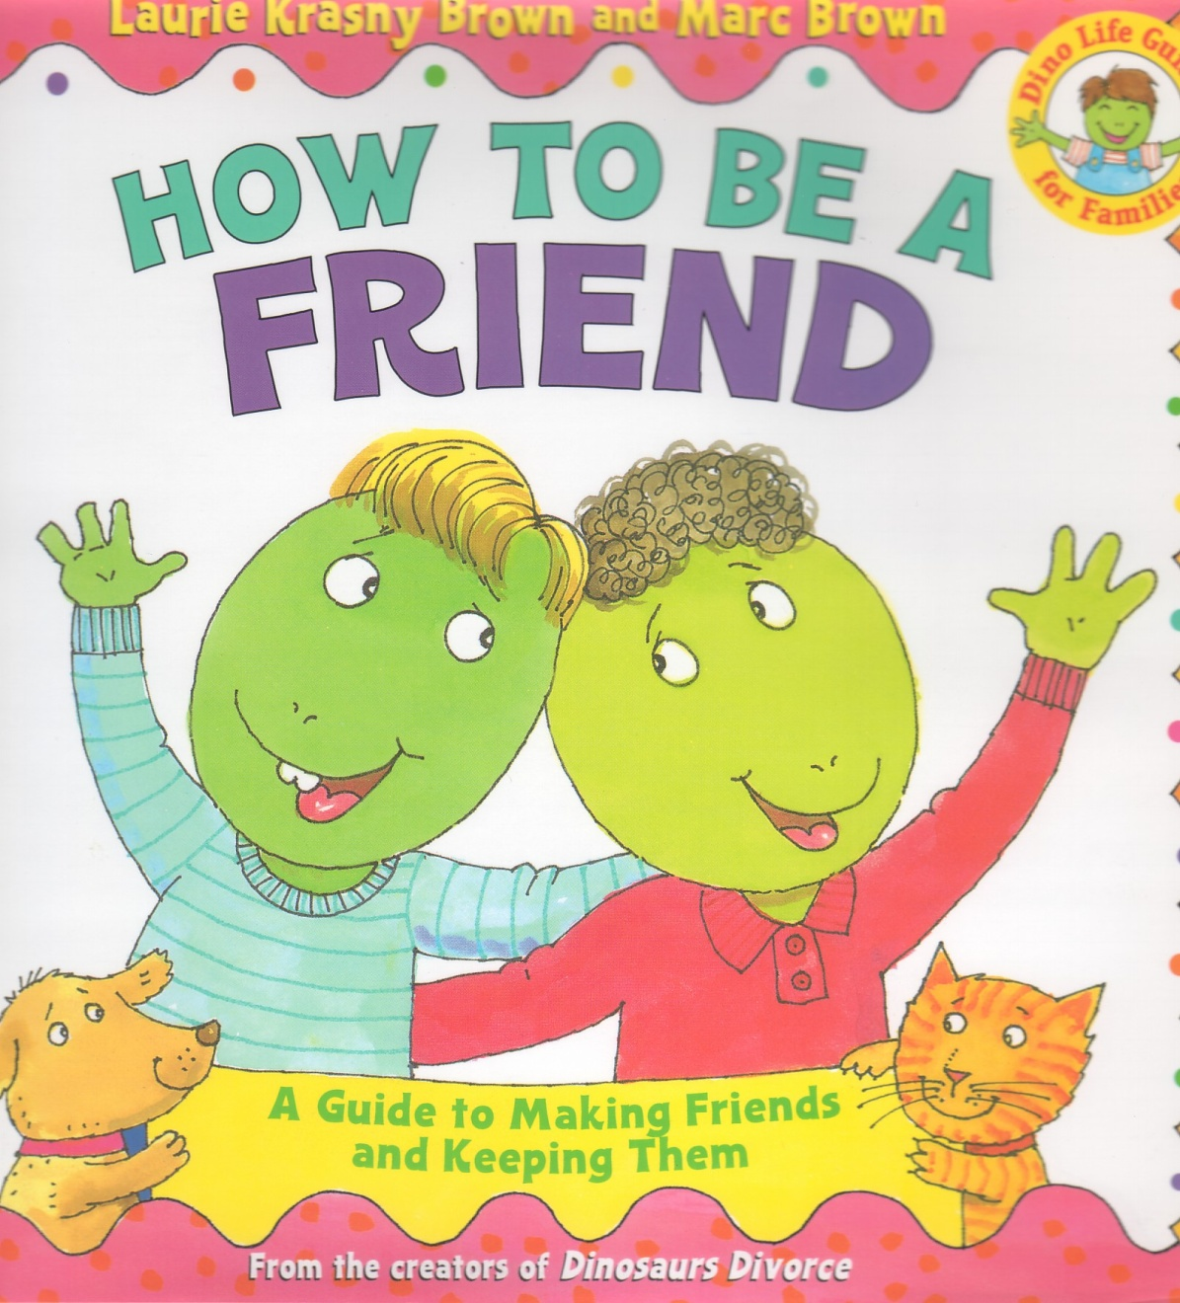

Slide 26
Conversation Skills
The art of attentive listening.
Topics of conversation (reciprocity).
Repairing a conversation – seeking clarification
Narrative ability

Slide 27
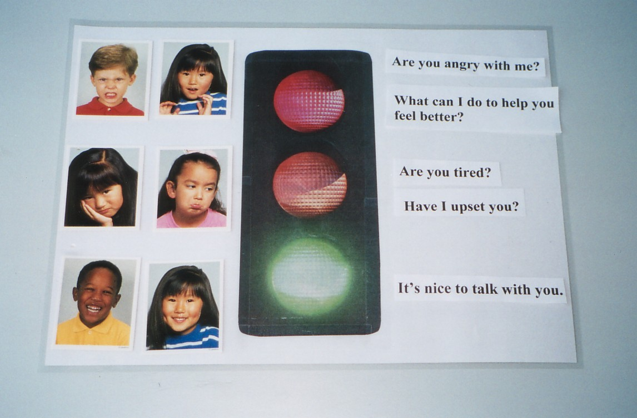
Social Signals
Road signs: Traffic lights

Slide 28
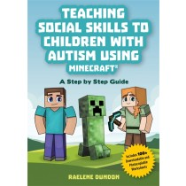
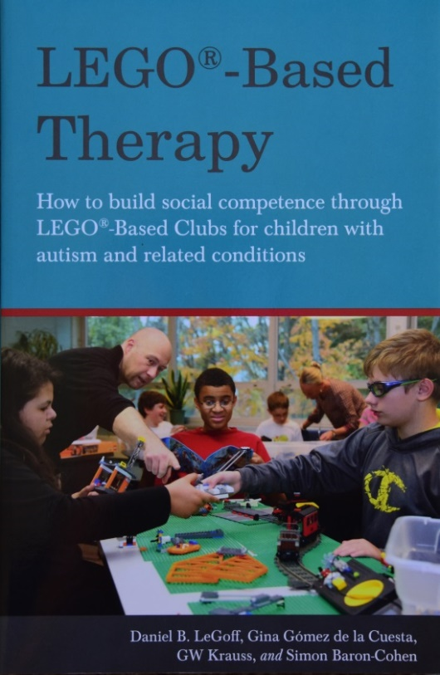
Friendship Opportunities
Develop friendships through the special interest
Lunch and after school clubs based on special interests such a movie trivia, computer games
Lego Therapy and Minecraft

Slide 29
Social Curriculum: Stage 2
Compliments (given, received)
Criticism (appropriate)
Cooperation (contributes to common goal, accepts the rules of the game, patient, aware of personal body space, touch, copes with mistakes, interruptions, gives encouragement)
Conversation (keeps on track, avoids monologue, literal interpretation, volume, humour)

Slide 30
Social Curriculum: Stage 2
Conflict resolution (compromise, avoiding anger, unfairness, forgives
Empathy (recognises the signals, words and gestures of support and affection)

Slide 31
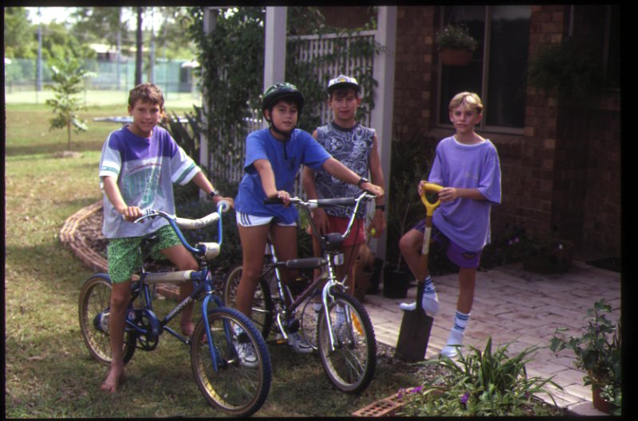
Stage 3 9-13 Years

Slide 32
Stage 3: Approximately 9 to 13 Years
Aware of others’ opinions of them and how their words and actions affect the feelings of others (white lie).
Need for companionship rather than functional play.
Cooperation more than competition.
Share thoughts rather than toys.
Personality characteristics, audacity, humour.
Helps in times of emotional distress.
Help the child feel good about themselves (compliments).
Greater selectivity and durability in friendships.

Slide 33
Stage 3: Approximately 9 to 13 Years
Gender split (Boy and girl activities).
Trust, loyalty and keeping promises.
Why is ….. your friend?
“I can trust her with my secrets.”

Slide 34
Friendship and Autism Research
Daniel and Billingsley 2010 Focus on ASD and other Dev Dis. 25
ASD boys aged 10 – 14 years
Making and keeping friends
Desire not to be the one who initiates contact
Intention to avoid violating the social hierarchy of peers at school
Concerns about being exploited or a nuisance
Establishing who might be a suitable choice for a friend

Slide 35
Autistic Friendships
Social ability gap with peers increases with each grade
Less able to rely on intuition , must rely more on cognitive abilities to process social situation
Peer interactions confusing, overwhelming and sometimes aversive
Experience bullying, teasing, rejection and humiliation
Not having a friend to repair or refute derogatory comments and restore a sense of trust
Difficulty in friendship situations that have not been seen before or rehearsed
Criticized by peers for making a simple social error

Slide 36
Autistic Friendships
Lack of a friendship mentor for guidance and positive feedback
Social exhaustion It takes all my brain power to be a friend
Needing time after school (and before falling asleep) to intellectually process the day’s social experiences
Friendships may end at the school gate
Resist parents’ suggestions to contact friends and engage in extra-curricular activities

Slide 37
Autistic Friendships
Anxious about their social abilities, rejection and fear of being laughed at
Development of social phobia and increased social withdrawal
Depression, I always make mistakes and always will
I’d rather just be alone, but I can’t handle the loneliness
Loneliness and isolation
Need a friend for: a second opinion regarding the motives and intentions of others and
Effective emotional monitoring and repair mechanism

Slide 38
Autistic Friendships
Seeking a sense of connection
May be accepted by a marginalized group that engage in activities and interests of concern for parents and teachers such as alcohol and drug consumption
Unsure of the social conventions of social media
Reject a friend if they make a social transgression

Slide 39
ASD and NT Girls Research
Sedgewick, Hill and Pellicano Autism (2018)
ASD and NT girls emphasised that friends supported them
People who are there for you
ASD girl My friend helps me if I don’t understand what the other girls mean
ASD and NT girls, friends act as mediators
Most ASD girls had one or two close friends seeing other people solely as classmates

Slide 40
ASD and NT Girls Research
Friends are hard work
Arguments with a close friend could be devastating as:
You have no one else to go to
Conflict Resolution
NT girls described conflict resolution as a reciprocal process with joint problem-solving
In contrast, ASD girls described an ‘all-or-nothing’ approach, either taking sole responsibility or ending the friendship entirely as the other person is the wrong-doer

Slide 41
ASD and NT Girls Research
Online Interactions
Girls: to be visible to others in their social networks
The number of ‘likes’ a photo got was a key measure of how popular girls felt
Overall autistic girls:
Have fewer, more intense friendships
Less socially competitive and aggressive
Struggle more to manage friendship conflict

Slide 42
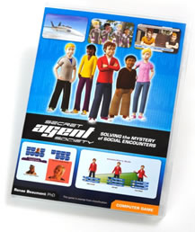
Social Skills Resources
Secret Agent Society computer game & board game
www.sst-institute.net
Notes:
42

Slide 43
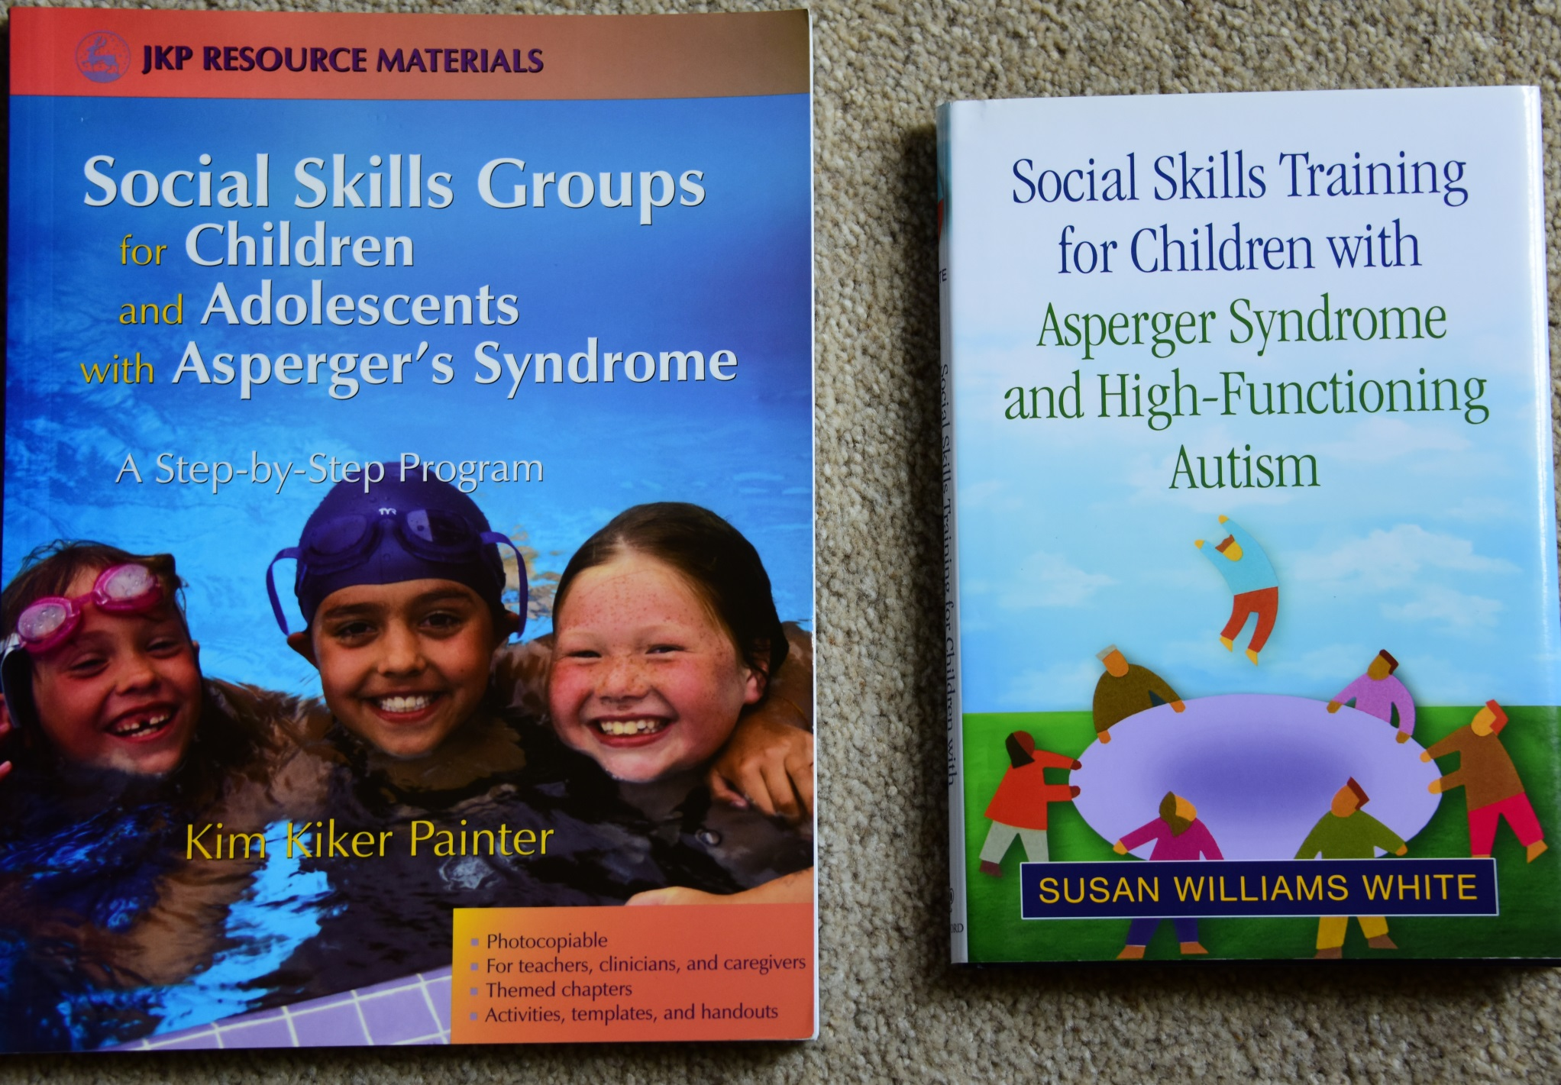

Slide 44
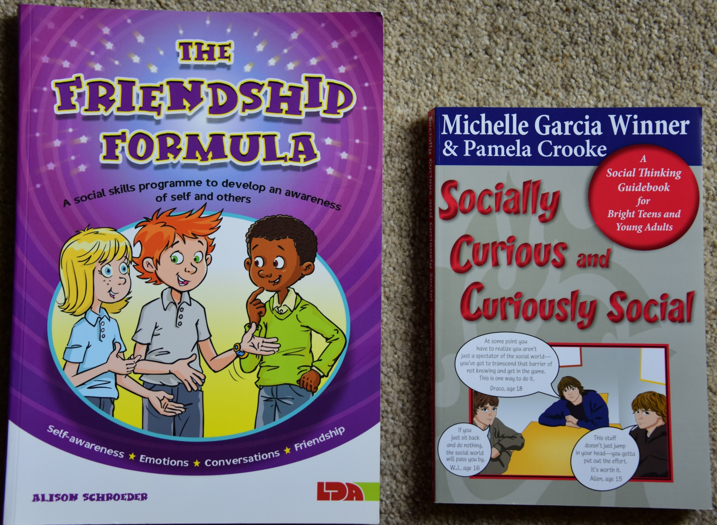

Slide 45



Social Thinking
Resources and programmes developed by Michelle Garcia Winner and Pamela Crooke
www.socialthinking.com
Online training

Slide 46

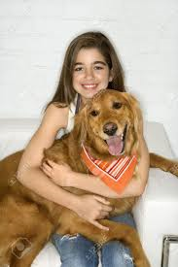
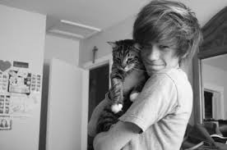
Animals as friends
Internet friends

Slide 47

Stage 4: Adolescent Friendships

Slide 48

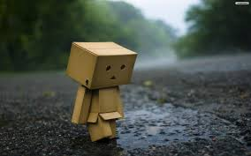

Loneliness and Lack of Connection

Slide 49
Adolescent Friendship Research
Cresswell, Hinch and Cage (2019) Research In ASD 61, 45-60
Systematic review of research
Struggling to understand covert social rules
When identifying rules, not always able to follow them
Could identify qualities they would find important in a friend
More emphasis on shared interests and activities, less on affection and emotional support
Wanting to adapt to become ‘cool’ while others intent on staying true to themselves

Slide 50
Autistic Adolescent Friendship Research
Dean et al. (2023) Women’s Health 19
Autistic students reported more loneliness when they were mutually engaged with social groups than when alone (sense of connection)
Difficulty in maintaining not initiating social engagement
A pattern of repeated rejection and victimisation contributes to the development of loneliness
Autistic adolescent girls may find being alone without camouflaging is less lonely than hiding aspects of their identity to fit in
To facilitate the maintenance of peer interaction, autistic adolescents would benefit from programs to increase conversational skills

Slide 51
Autistic Friendships
Not able to rely on intuitive abilities in social settings
Peer interactions are confusing and sometimes aversive
Difficulty in friendship situations that have not been rehearsed or prepared for
Difficulty reading covert social rules and peer conventions
Criticized by peers as being a ‘social retard’
Autistic as a derogatory term
Difficulty with emotional disclosure (alexithymia)

Slide 52
Autistic Friendships
Lack of a friendship mentor to provide guidance and constructive and positive feedback
Friendships end at the school gate
Resist parents' suggestions to contact friends or engage in extra-curricular activities
No motivation and energy to socialize any more

Slide 53
Autistic Friendships
Recognition of not being popular
I wasn’t rejected but did not feel completely included
I was supported and tolerated but not liked
Blame themselves or being autistic for peer rejection
Affects self-esteem, self-identity, mood and perception of autism

Slide 54
Autistic Friendships
Anxious about making a social mistake
I live in constant fear of performance anxiety over day-to-day social encounters
Before falling asleep reviewing the social experiences of school – ruminating on social performance
Conscious retreat into solitude
I’d rather just be alone, but I can’t handle the loneliness

Slide 55
Autistic Friendships
Yearning for a sense of connection
Experience rejection from popular friendship groups
Accepted by marginalized teenagers that engage in activities and interests that cause concern for parents
Alcohol and drug use, eating disorders
The group ‘adopt’ the autistic teenager
A new intense interest in information valued by the group

Slide 56
Autistic Teenage Girls
Try to fit in during Primary School by being ultra-feminine (pink and frilly)
In adolescence, when it is not working, the pendulum can swing the other way
Despise femininity and defy social and gender conventions
Prefer the company of boys, socially simpler, interest in sporting ability, science, adventure

Slide 57
Autistic Teenage Girls
Camouflaging: Developing an interest in and knowledge of fashion and makeup.
Masks and mimics
Why go to all the effort of figuring out what normal is when you can just copy it.
Autism camouflaged and suppressed at school but released at home
Jekyll and Hyde character

Slide 58


Teenage Autistic Girls
Puritanical
Sexuality to be popular
Vulnerable to relationship predators

Slide 59
Friendship Curriculum
Rothman and Holmes Autism 26, 160-168
25 autistic individuals aged 16-22 years
Friendships and healthy relationships (HEARTS programme)
1: Motivation to make and maintain friendships
Motivation to keep the relationship going
My challenge is actually staying in touch and making the effort to actually feel like I want to talk to them

Slide 60
Friendship Curriculum
For some participants, spending time alone and enjoying free time was a more attractive option than socializing with others
Forgetting to continue to invest in a relationship
One participant created a social checklist
2: Overcoming anxiety
Needing much reassurance due to anxiety about being rejected or being manipulated and abused
Emotional scars from previous friendships

Slide 61
Friendship Curriculum
3: Taking emotional risks
A desire to learn more about how to deepen healthy relationships
From a superficial level into more emotional intimacy
How to feel more closely connected to peers and experience more trust and cohesion
Opening up and making various types of self-disclosures
When and how to disclose feelings and to whom

Slide 62
Friendship Curriculum
4: Cultivating reciprocity
Mutual interests, equality and balance in relationships
Finding people who would be interested in friendship and would be good friends
The ‘chemistry’ of friendship
Distinguishing between healthy and unhealthy relationships
An imbalance in initiation and becoming increasingly discouraged about a developing friendship
It was a one-way street and it was me doing all the initiating

Slide 63
Friendship Curriculum
5: Creating, maintaining and respecting boundaries
Setting healthy boundaries and trust
A depressed friend
They were struggling through depression and I ended up essentially becoming their therapist. They would call me at all times, needing to talk through something.
Learning how to set and respect sexual boundaries

Slide 64
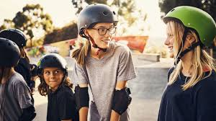
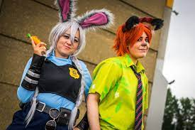
Friendship Encouragement
An autistic friend
Find each other on the periphery of social activities
Lunchtime or after-school interest groups such as robotics, computer programming, science project, playing music and singing together
Sitting beside each other drawing
Comic Book, Cosplay and fan conventions

Slide 65


Drama Classes and Drama Therapy
How to act in everyday situations.
Autistic adolescents feel they are ‘acting’ with peers but do not have a script, role, storyline
“Like being in a play and all the other actors know their lines and you have never seen the script”

Slide 66
Friendship Activities for Parents
Puzzling Peers
Peers congregating and talking about nothing of substance or about boys
Someone talking about her experiences and opinions and thinking that I (and others) would be interested
Awkward situations
You walk into class late and everyone turns to look at you
A friend says “I’m so fat” and looks at you for a comment, probably anticipating a ‘white lie’

Slide 67
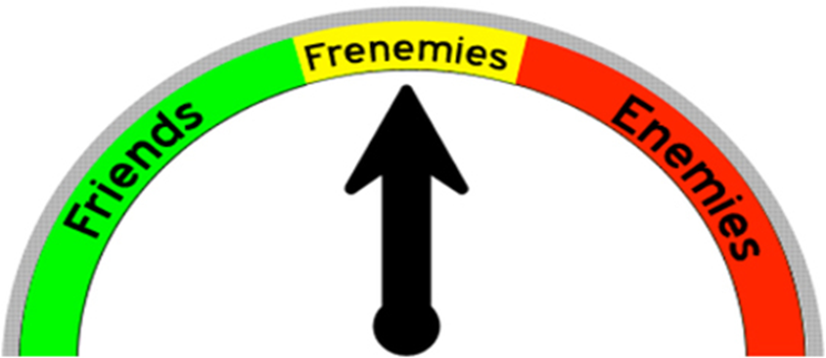
Friendship Activities for Parents
Risky friendships and situations
Signs of a good friendship
Signs a friendship is becoming risky in terms of emotions, what you do together and feeling used
How can you recognise these signs?

Slide 68

Friendship Activities for Parents
Questions to elicit more information
Am I reading you right?
I’m confused as to what you mean
Rehearsing conversations and situations

Slide 69

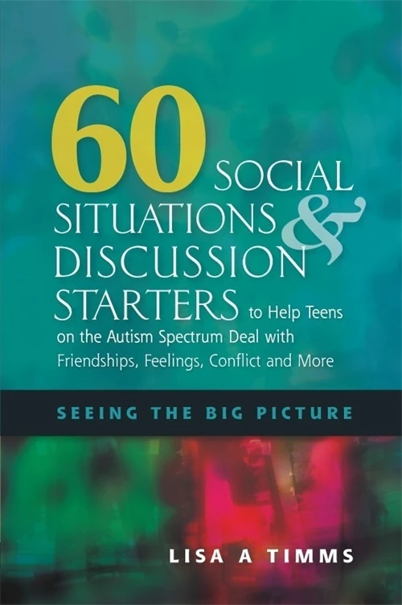
Resources for Parents and Therapists

Slide 70

Social Skills Training
Laugeson et al. (2015) Journal of Autism and Developmental Disabilities 45, 3978-3989
PEERS program
Young adults with HFA 18-23 years
Topics:
Conversation skills
Electronic forms of communication
Developing friendship networks and finding friends
Appropriate use of humour

Slide 71
Social Skills Training
Peer entry and exit strategies
Organizing a get-together with friends
Teasing and embarrassing feedback
Dating etiquette
Handling peer pressure and avoiding exploitation
Resolving arguments with peers

Slide 72

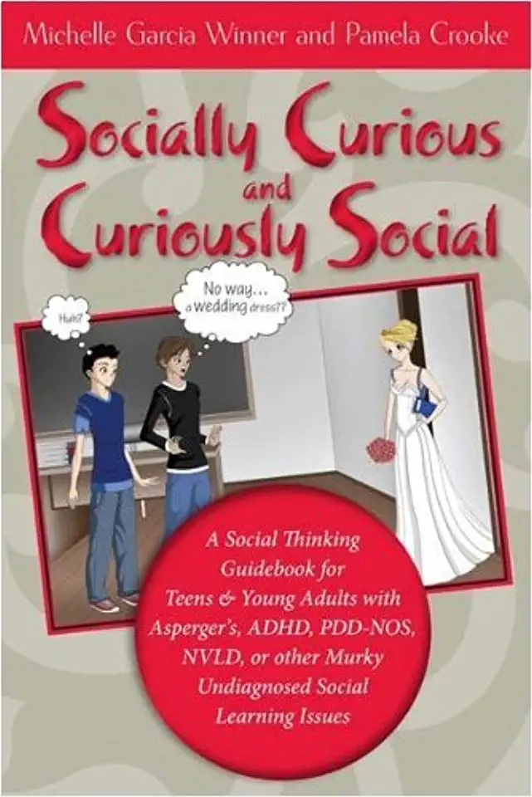
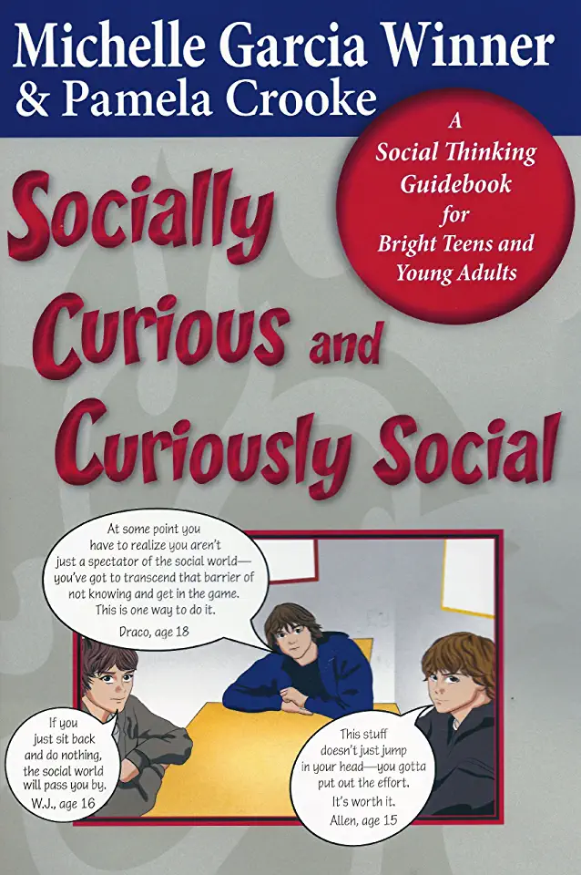
Social Thinking
Resources and programmes developed by Michelle Garcia Winner and Pamela Crooke
www.socialthinking.com
Online training

