Slide 1
Warrnambool 7th March
Managing Feelings

Slide 2
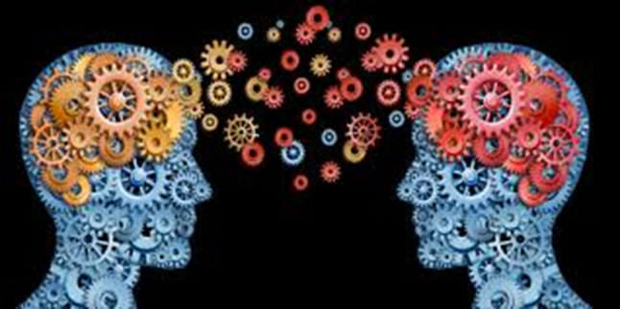
Reasons for Difficulties in Expressing and Managing Emotions
Theory of Mind
Ability to read and interpret the cues and context that indicate someone’s feelings, thoughts, intentions and beliefs (Alien)
Ability to self-reflect, to perceive and think about one’s own thoughts and to monitor, communicate and manage one’s own emotions (inner turmoil)
Double empathy, reading autistic cues
Mum, separation anxiety and sleep

Slide 3
Exteroception and Interoception
Exteroception
Sensing the outside world
Sound
Sight
Touch
Smell
Taste
Emotions in other people
Interoception
Sensing the internal world
Pain, illness (vomiting)
Heart rate, breathing
Hunger
Sleepiness
Temperature
Emotions within yourself
Alexithymia

Slide 4
Perception of Inner Signals
Diagnostic assessment of an adult
“How did you know…….?
“I only know what I am feeling by seeing what I am doing”
Processing time, minutes to days

Slide 5
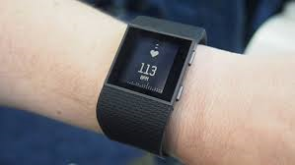
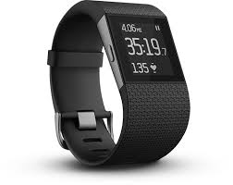
Measurement of Heart Rate
Sports technology to measure heart rate
Signs of increasing agitation
Signs of increasing relaxation
Data on heart rate throughout the day and to a specific event

Slide 6
8:55 School bell rings (Beats Per Minute 149) Each day that week, his class teacher was different. He was worried who is teacher would be.

Slide 7
Autism Assistance Dog

Slide 8
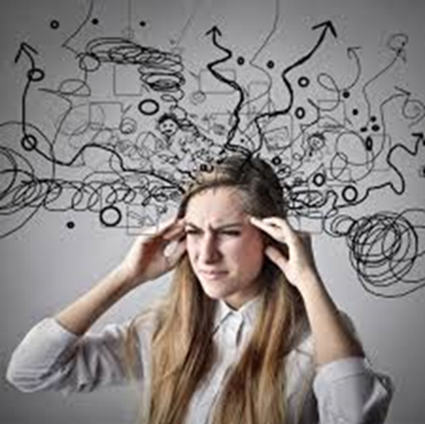
Alexithymia
A diminished vocabulary to describe the different levels of emotional experience
Especially subtle and complex emotions- It’s just an ‘icky’ feeling
“I need a language for my worries” An 8-year-old autistic boy

Slide 9
Alexithymia
“How were you feeling?”
“I don’t know”
‘I don’t know….how to mentally grasp the intangible negative emotions swirling in my mind, identify and label them accurately and communicate those feelings in speech so that you will understand’

Slide 10
Strategies for Alexithymia
Using music or art to express the emotion or thought
Poetry, lyrics, and novel writing
Google images
Scenes from movies, passages from a book
Typing rather than talking (email)

Slide 11
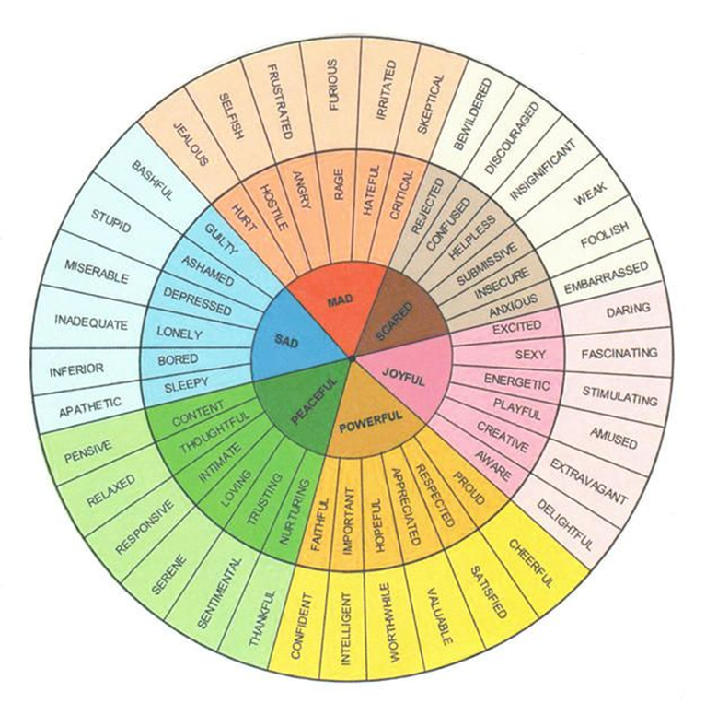
External Prompt
© 2023 Attwood & Garnett Events

Slide 12
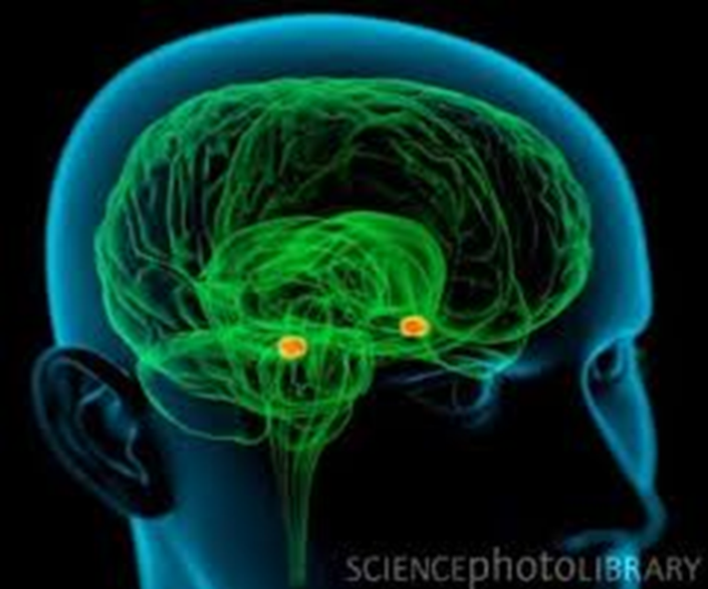
Neurology: Amygdala

Slide 13
Genetics and Puberty
Family history of mood disorders
A deluge of anxiety with the onset of puberty
Strength and depth too great for psychotherapy (CBT) and prescribed medication
Use extreme behaviours (self-harm, illegal drugs, recluse)

Slide 14
Social Experiences
Being bullied, teased, rejected, and humiliated by peers and siblings
Feeling judged by peers and adults
Fear of social ‘performance’ and making a social mistake (Self-critical)
Too many people –playgrounds, school assembly and crowds
Not knowing the social ‘script’ in new social situations

Slide 15
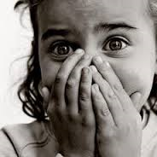
Emotional Sensitivity
Overly sensitive to another person’s negative mood
Hyper-sensitive to disappointment, anxiety or agitation
Wanting everyone to be happy

Slide 16
Emotional Empathy
There’s a kind of instant subconscious reaction to the emotional states of other people that I have understood better in myself over the years
If someone approaches me for a conversation and they are full of worry, fear or anger, I find myself suddenly in the same state of emotion

Slide 17
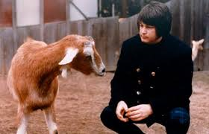
Emotional Empathy
I am able to distinguish very subtle cues that others would not see, or it might be a feeling I pick up from them
A ‘sixth sense’
Avoidance of some social situations due to being sensitive to ‘negative vibes’ – emotional protection

Slide 18
Adaptive Thinking
Maladaptive
Adaptive
Positive refocussing (good bits)
Positive reappraisal (optimism)
Refocus on planning (flexible thinking)
Putting it in perspective
Self-soothing (inner conversation)
Self-blame*
Catastrophizing*
Blaming others*
Ruminations*
* characteristic of autism

Slide 19
Emotion Education
“I need a language for my worries”

Slide 20
Emotion Projects
Happy- Sad.
Relaxed-Anxious.
Affection-Anger.
Problems with emotional arousal for both negative and positive emotions.
Rapid expression of extremes of emotion

Slide 21
Affective Education
A project on a specific emotion.
Start with happiness or pleasure.
Create a scrapbook that illustrates the emotion.
Diary of new experiences.
Compare and contrast other children’s scrapbooks.

Slide 22
Examples of activities-Happiness
What are the feelings and sensations when you are happy?
Rope activity. Stand at the point that represents the level of feeling. Examples: You find and can keep $20, Your mother says that she loves you
Happiness thermometer (the special interest, solitude and animals).
How much do you like…..?(1-10).
What could your mother say to make you feel happy? (Feeling rated from1-10).

Slide 23
Emotion Education
A ‘thermometer’ to measure the degree of intensity
Place photographs and words at the appropriate point on the ‘thermometer
Increase precision and accuracy in verbal expression Alexithymia

Slide 24
Affective Education
Appropriate tone of voice. (counting,)
Different ways to say “Yes” or “come here”
Select a word or phrase and a mood and say the word according to the mood
Drama games for body language (charades)

Slide 25
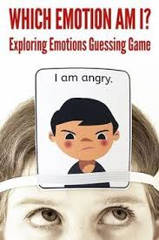
Emotion Games

Slide 26
Affective Education
Emotion statues (sad/embarrassed)
Non-verbal sounds and signs (cough, tut, mmm).
Guess the message (raised eyebrow, frown).
Music (play list)
Drawings and colour to represent the emotion

Slide 29
K.I. Al-Ghani
www.jkp.com

Slide 30
Social Stories
Developed by Carol Gray, can be used to learn about emotions, and anxiety in particular.
Siobhan Timmins describes how her autistic son was ‘not able to identify calm in himself, which made it impossible for him to work out how to calm himself down’.
She created a series of Social Stories, such as ‘What are worries?’, ‘What is feeling calm’, and ‘What does calm down mean’ (Timmins 2016).

Slide 31
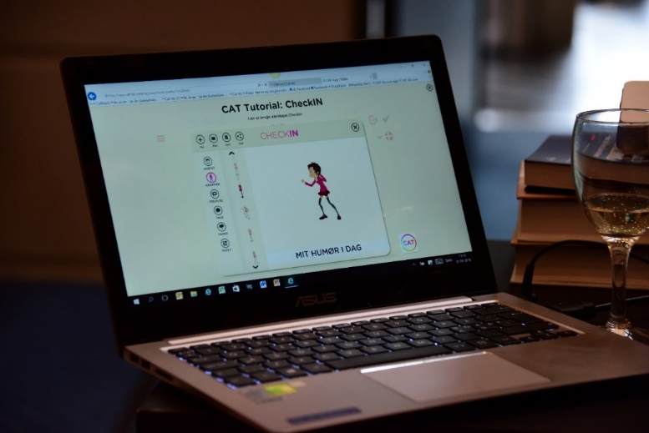
The CAT-kit www.cat-kit.com/en-gb/

Slide 34
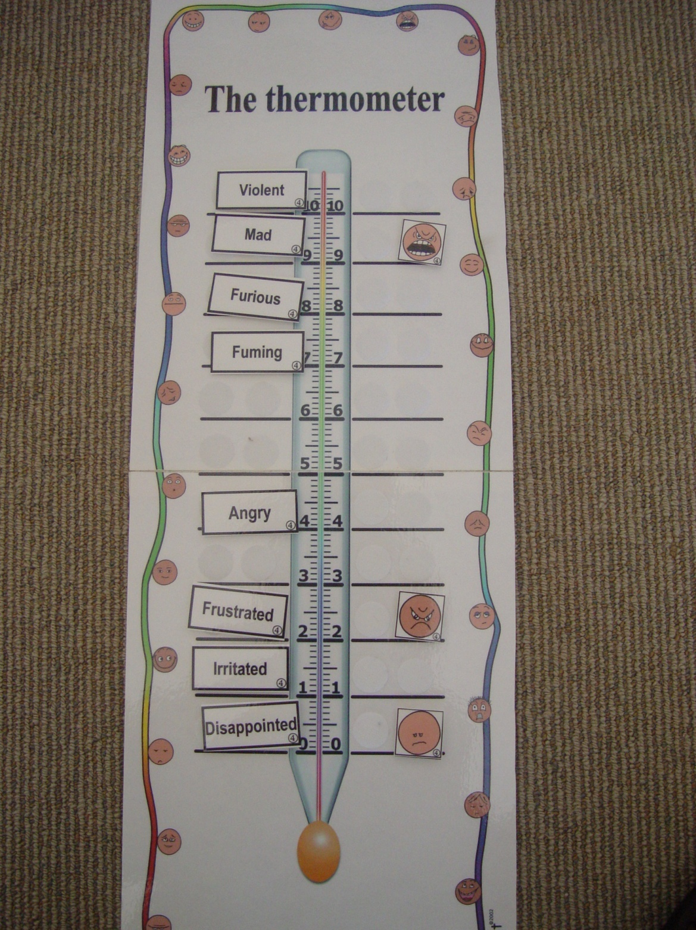

Slide 35
Structure to organize emotional experiences

Slide 37
Apps
Bronwyn Sutton
www.bestautismtherapy.com.au
The Learning App Guide to Autism and Education
Reviews apps on emotions

Slide 38
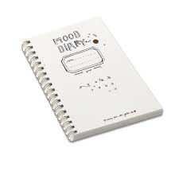
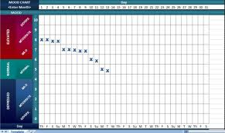
Emotional Tides
Mood diary

Slide 39
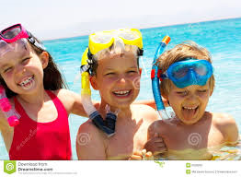
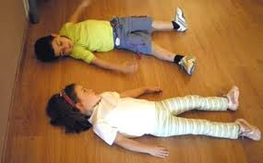
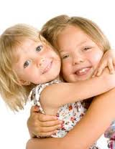
Problems Expressing and Enjoying Positive Emotions
Difficulty resonating with the happiness of others
Knowing how to relax
Needing to learn how to respond to and express affection

Slide 40
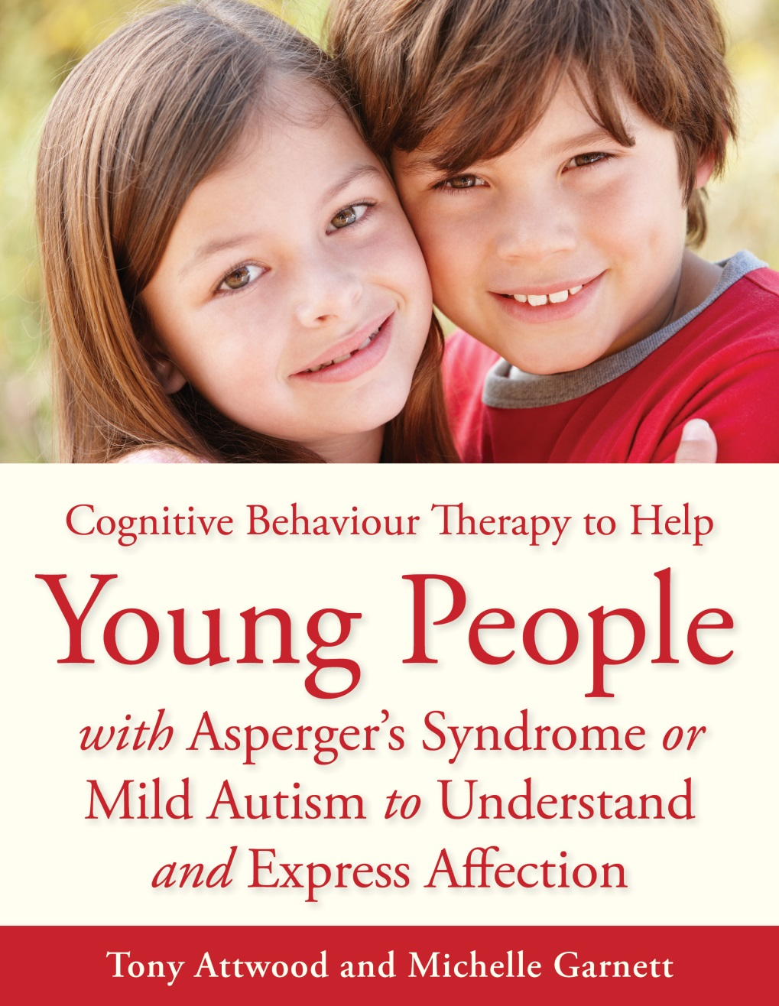

Slide 41
Anxiety
86% of over 300 autistic adults reported having daily problems with anxiety

Slide 42
Anxiety
Richard Maguire explained, “I call anxiety the permanent emotional state for autistic people… anxiety is my constant companion. Much of my life and strength have been used up on anxiety.”

Slide 43
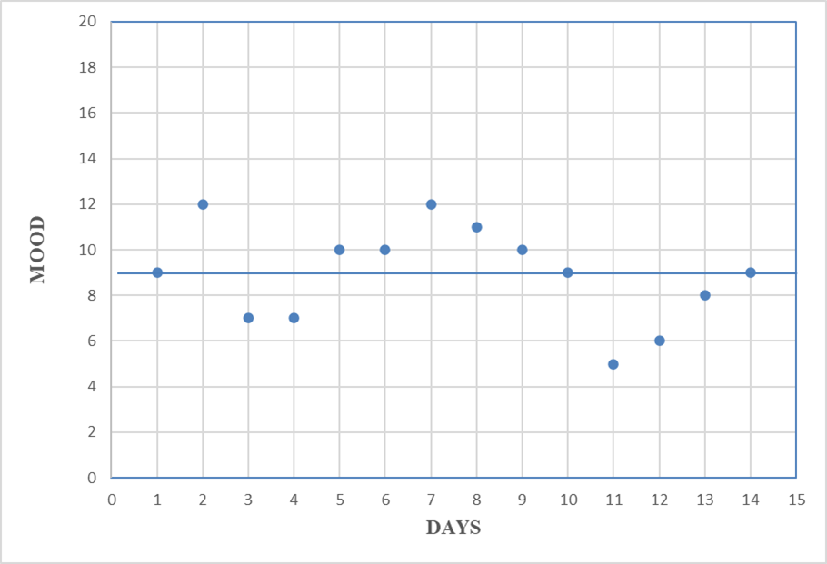
Autism and Emotional Tides
Degree of autism or mood diary

Slide 44
Triggers for Anxiety
Transitions (especially if rushed)
Making a mistake
Getting off schedule or routine
Failure of others to follow rules
Over-sensitivity to sensory stimuli
Abandonment (separation from a parent)
Unexpected environmental change (rearrangement of furniture)
Crowded social places (standing in line, cafeteria)
Unwanted social attention
Being teased
Uncertainty

Slide 45
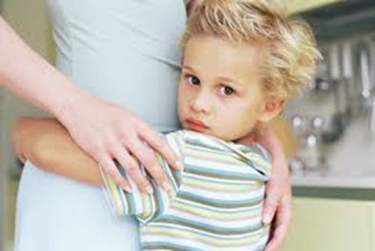
Unusual Fears
Weather (thunder)
Toilets (smell, sound)
Swings (balance)
Wind (tactile)
Can be associated with sensory sensitivity

Slide 46
Anxiety and the Fight, Flight, Freeze Response
Fight
Threatening language and actions
‘Attack’ mode for self-protection
Flight
Escape the situation or make you leave them alone (threats) – I go, or you go
Escape into imagination and fantasy
‘Freeze’
Shutdown
Situational muteness

Slide 47
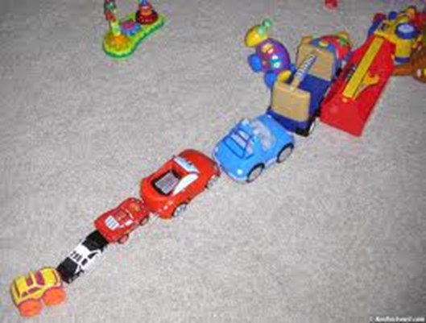
Coping with Anxiety
Routines and rituals
Soothing and relaxing, to feel calm
Can become compulsions to alleviate feeling anxious
Become prolonged and more elaborate

Slide 48
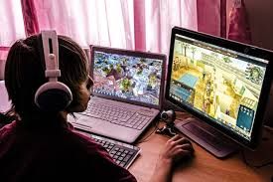
Coping with Anxiety
Thought blocker
Suppression and compression
Special interest
Computer games

Slide 49
Control and Autonomy
To avoid experiencing uncertainty and anxiety
Controlling events and people
Dictatorial and imposing demands
Not complying themselves with requests as to comply is to surrender autonomy
PDA - Persistent Drive for Autonomy

Slide 50
Coping with Anxiety
‘Freeze’ (an involuntary coping strategy)
Shutdown
Social withdrawal
Mute
I can’t do it PDA

Slide 51
Coping with Anxiety
Explosion or melt-down
To cleanse the system or clear the air
“It’s a bit like wanting to vomit and knowing you will feel ill until you actually throw up. You get it over and done with and feel better. Getting it out of your system”
Reset button
Negative reinforcement

Slide 52
CBT Programs for Anxiety in Autistic Children
Exploring Feelings (Attwood 2004)
Cool Kids (Chalfant et al 2007)
Facing Your Fears (Reaven et al 2011)
Building Confidence (Fujii et al 2013)
Coping Cat (Keehn et al 2013)

Slide 53
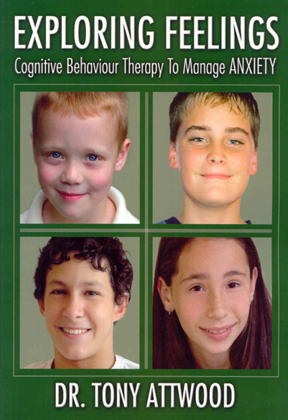
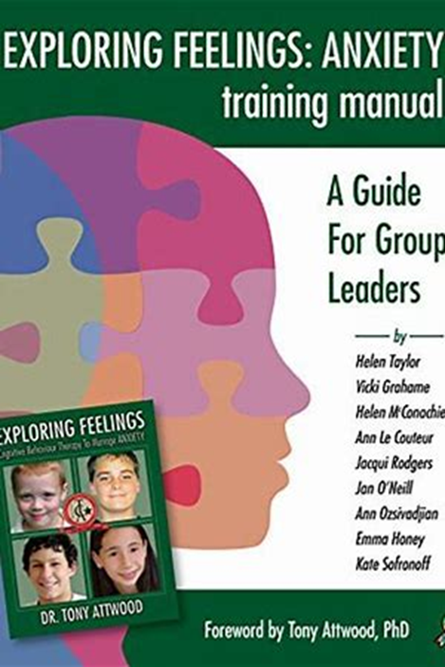
Exploring Anxiety and Anger www.FutureHorizons-autism.com
4 RCT Evaluations of Exploring Feelings for Anxiety

Slide 54
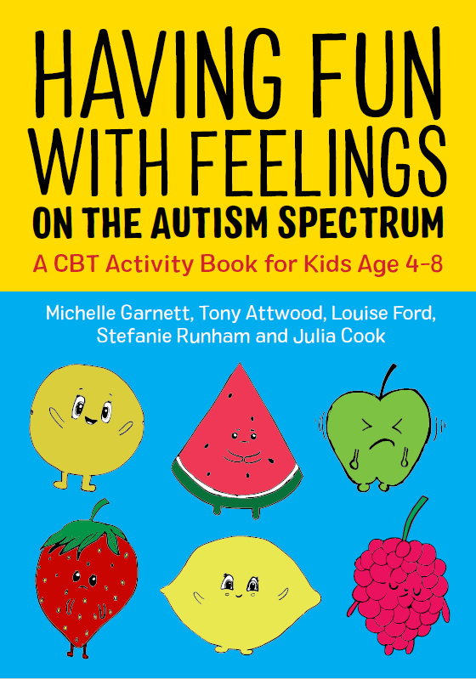
www.jkp.com

Slide 55
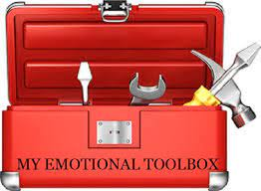
Emotional Toolbox (story of mum sad)
Self-awareness Tools: meditation, Yoga, Mindfulness
Physical Tools: energy release
Sensory Tools: For freedom from pain
Relaxation Tools: For feeling calm and confident
Art, music alexithymia
Interests or passions for pleasure

Slide 56
Emotional Toolbox
Social Tools: To feel connected, gain help and combat loneliness
Thinking Tools: Adaptive thinking
Medication Tools: To reduce the depth and duration of feeling anxious
Inappropriate Tools: self-harm, illegal drugs

Slide 57
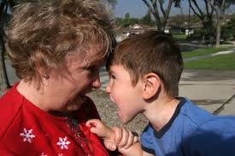
Meltdowns
Two types of meltdown
Outward directed and ‘blind rage’, try to strike out and destruction Explosion
Inward directed, despondent, a depression ‘attack’ Implosion

Slide 58
Managing a Meltdown
Do
Stay calm
Affirm and validate the child’s emotion
One person dealing with the situation
Confirm the feeling will go
Keep other people away
Minimal speech
Special interest as an ‘off switch’
Seek a safe place for solitude
Not Do
Interrogation
Focus on punishment and consequences
When I’m upset, the last thing I want to do is talk to someone
I can hear but my brain can’t process what people say
Try not to jolly up or use comfort and affection
Human comfort has always been a mystery

Slide 59
Anger

Slide 60
Triggers for Agitation
No
Wait
Hurry up
Change
Not fair
Teasing and bullying

Slide 61
Anger
Frustration due to being thwarted from access to strategies to reduce anxiety
Dominance and control (Anxiety)
Anger due to not being valued and accepted (hating the world)
Not knowing what else to do (one-track mind)
Agitated externalised depression (attack mode)

Slide 62
Sadness Expressed As Anger

Slide 63
Depression
One in three autistic adolescents have signs of a clinical depression
Those signs may have been apparent as young as 7 years old
Treatment needs to address many aspects of autism
© 2023 Attwood & Garnett Events

Slide 64
Exploring Depression and Beating the Blues
© 2023 Attwood & Garnett Events

Slide 65
Characteristics of Depression Associated with Autism
A change in the special interest to a morbid or macabre topic
Watching movies with a theme of death and despair
An attempt to understand morbid thoughts and deep negative inner emotions
© 2023 Attwood & Garnett Events

Slide 66
Characteristics of Depression Associated with Autism
Fewer, if any, friends to alleviate depression through compassion, reassurance, affection, distraction, and enjoyable social experiences
Difficulty resonating with or being infused by the happiness of others
Try to resolve depression by solitary, subjective thought or using the special interest as a thought blocker or energiser
Concept of self is based on the criticisms and rejection of peers rather than compliments and acceptance. The seeds of depression and the basis for negative self-belief
Camouflaging – mental exhaustion, non-authentic self
© 2023 Attwood & Garnett Events

Slide 67
This is Who I Am Book: Qualities in Personality and Abilities
Personality
Kind
Caring
A loyal friend
Honest
Forthright
A perfectionist
Determined
Brave
Humourous
Abilities
Drawing and art
Creating Lego models
Exceptional long-term memory
Talented in mathematics
Noticing details
Expert on ……
© 2023 Attwood & Garnett Events

Slide 68
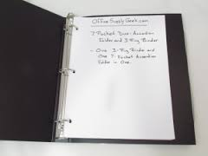
Ring Binder or Computer Programme
Each quality at the top of a page
Record examples of the expression of that quality (a diary)
Photographs, copies of reports and grades, compliments from friends and family
© 2023 Attwood & Garnett Events

Slide 69
Ring Binder or Computer Programme
Qualities of a hero in the family or character in a film or TV programme (e.g. Dr. Who)
Each admired quality of the hero has a page
Add entries throughout and after the programme
Confirming progress towards a valued personality
The book is an antidote to depression and builds a positive self-image
© 2023 Attwood & Garnett Events

Slide 70
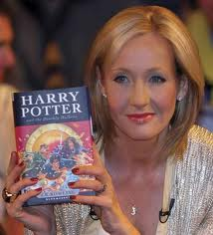
Appreciation
List at least 5 things you are grateful for
Create a collage to express the main things that you are grateful for in your life such as your:
Intelligence
Pet
Parents
Computer
Harry Potter
Star Trek

Slide 71
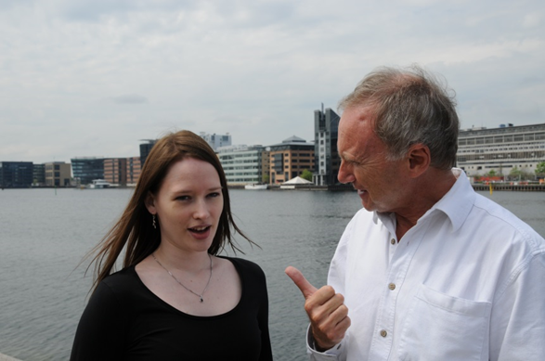
Energy Accounting
Maja Toudal: Concept of an energy bank account
Energy withdrawals and deposits throughout the day
Risk of energy depletion leading to depression
Energy depletion is a major cause of depression for autistic individuals
When I am emotionally depleted, I need to be disconnected to look after myself
© 2023 Attwood & Garnett Events

Slide 72
Energy Bank Account: Withdrawals and Deposits
Withdrawal
Socializing
Change
Making a mistake
Sensory sensitivity
Daily living skills
Coping with anxiety
Over analysing social performance
Sensitivity to other people’s moods
Being teased or excluded
Crowds
Government agencies
Body shape
Perceived injustice
Certain people
Deposit
Solitude
Special interest
Physical activity
Animals and nature
Computer games
Meditation
Caring for others
Nutrition
Sleep
Reading Harry Potter books
Mental health vacation day
Information on the Internet
Being with pets
Certain people
© 2023 Attwood & Garnett Events

Slide 73
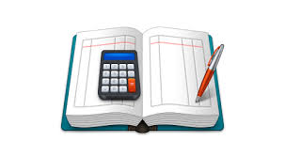
Energy Accounting
Currency: numerical measure or value of how much an activity or experience is energy draining or refreshing from day to day
Energy range rated from one to 100 for each activity or experience in the withdrawal or deposit columns
On some days, socializing can drain energy at a value of around 20 but on other days could be 100
© 2023 Attwood & Garnett Events

Slide 74
Energy Account Form
Withdrawals |  | Deposits
Activity/Experience | (0-100) | Activity/Experience | (0-100)
© 2023 Attwood & Garnett Events

Slide 75
Range of Energy Depletion and Refreshment: 15-Year-Old Girl Autistic Girl
Withdrawals
Deposits
Late to school 10-40
Crowds 20-60
Mum being cranky 30-100
Friends not being nice to each other 20-30
Friends’ own problems 20-90
Noise in class 20-30
Reading Harry Potter 30-80
Dancing freestyle in bedroom 30-50
Talking to boys at school 10-30
Quiet time in bedroom 20-80
© 2023 Attwood & Garnett Events

Slide 76
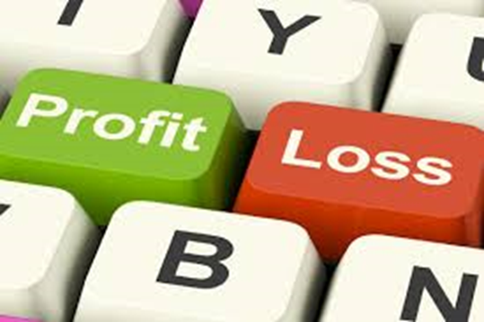
Balancing the Books
Add all the numerical values in each of the two columns to see if the energy bank balance at the end of the day is in debit or credit
If needed, schedule more energy-infusing activities into the next day or week
© 2023 Attwood & Garnett Events

Slide 77
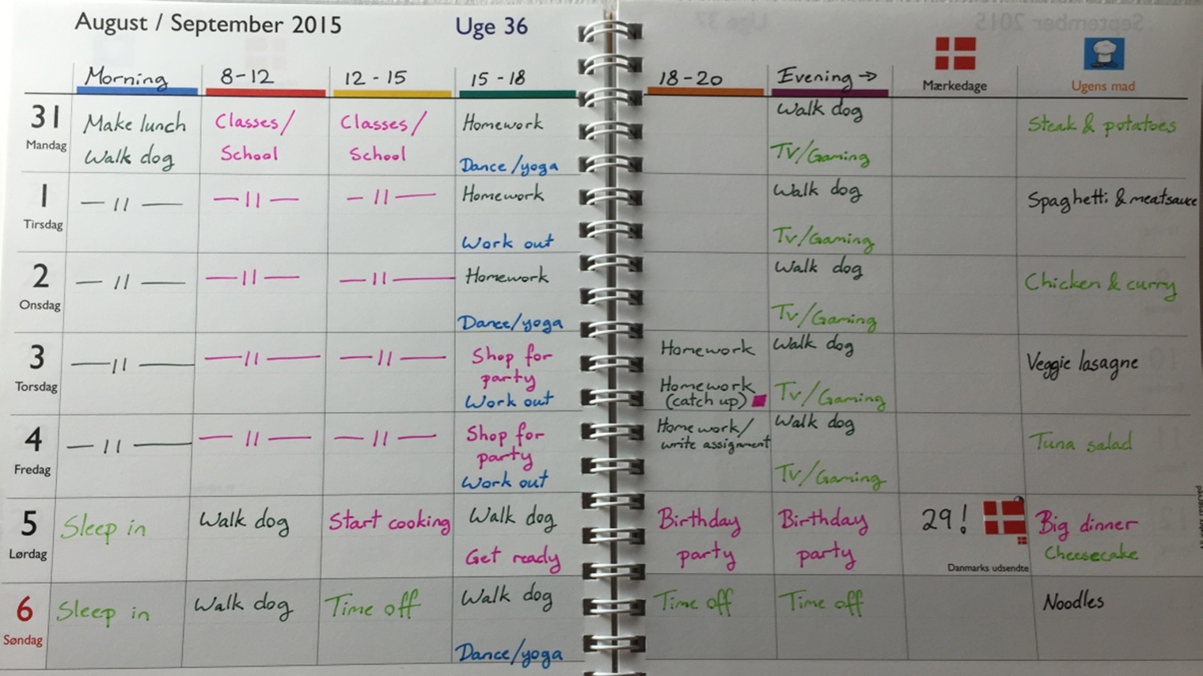
Energy Accounting
Add all the numerical values in each of the two columns to see if the energy bank balance at the end of the day is in debit or credit
If needed, schedule more energy-infusing activities for the next day/week
Colour coding system
Neutral
Recharging
Physical
Social
Draining
Other

Slide 78
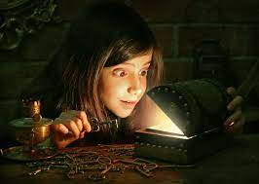
The Discovery of Autism
Moving from Diagnosis to Discovery
Autism defined by strengths
Advantages in social interaction
Loyal and dependable, speaking one’s mind, avoiding ritualistic small talk, seeking sincere, genuine friendships, exchange of valuable information and advice
© 2023 Attwood & Garnett Events

Slide 79
Self-affirmation Pledge Liane Holliday Willey
I am not defective
I am different
I will not sacrifice my self-worth for peer acceptance
I am capable of getting along with society
I will ask for help when I need it
I will be patient with those who need time to understand me
I will accept myself for who I am
© 2023 Attwood & Garnett Events

Slide 80
Autism Associated With Famous Individuals in Science and Art
Albert Einstein.
Alan Turing.
Thomas Jefferson.
Howard Hughes.
Hans Christian Andersen
Jane Austen
Marie Curie
Greta Thornberg.
Sophie Germain (mathematician)
Bobby Fischer
Temple Grandin
Howard Hughes
Carl Jung
Gary Numan
Tim Page
B.F. Skinner
Andy Warhol
Thomas Edison

